Slide 1
i-Transport Internal Briefing

Slide 2
9:00 : Meeting in Mountbatten
9:00 - 9:45 : Presentation to brief the team
9:45 - 12:00 : Bus Tour
12:00 - 13:30 : Lunch

Slide 3

Question:
What is i-transport about?

Slide 4
What is i-transport?
A Traffic Management System (TMS), also C2 system
LTA ITSC key platform to:
Manage Road Incident
Manage Events (F1, National Days, etc.)
Manage Traffic Condition
Disseminate Traffic News to public
Monitor and Control Equipment on the road
Traffic Data Analysis platform
i-transport key user group is LTA ITSC Operators
Providing 24/7 services to ensure Singapore Land Transport is smooth to travel
3 shifts a day
i-transport can be understand as the Centre/Core of the ITSC systems. All the critical system are providing their services via i-transport.

Slide 5
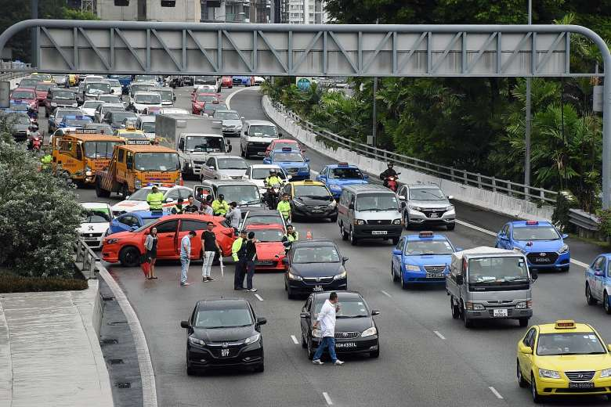
How i-transport helps LTA?
Traffic Incident (Accident, Road Works, Heavy Traffic, Obstacle, Vehicle Breakdown, etc.)
Traffic Event ( e.g. F1, National Day, etc.)
Alerts
Monitor
Respond plans ( VMS messages, Dissem Message, OBU, Traffic Light, Third Party Coordination, etc.)
Tracking
Dissemination
Road Equipment (VMS)
Traffic News on Internet (e.g. OneMotoring)

Slide 6
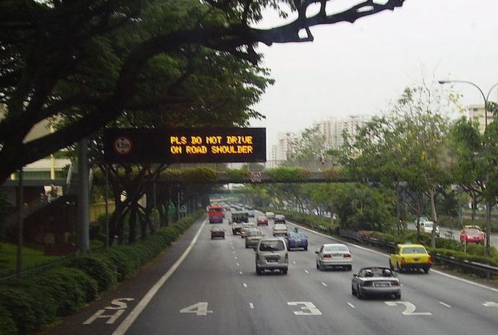
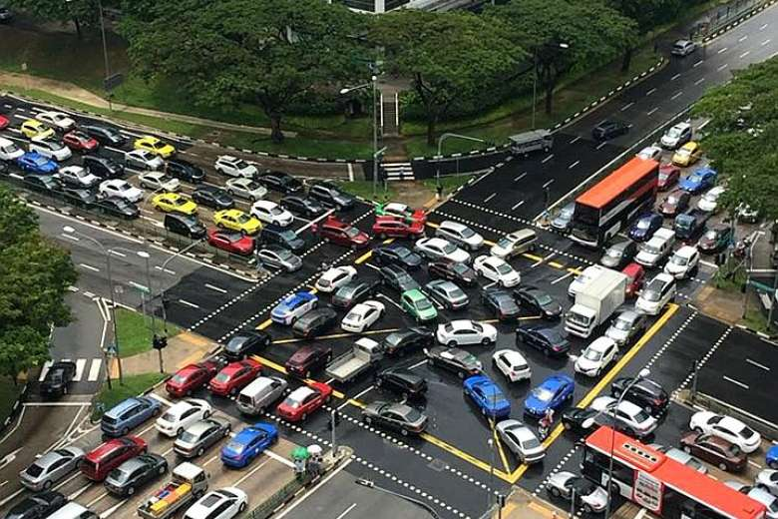
How i-transport helps LTA?
Daily Equipment management
VMS Messages (e.g. ERP message, Safely Drive message, etc.)
Tunnels Equipment
Technical status
Environmental status
Traffic Junction Status
Unusual Congestion
Traffic Junction Failure
Other equipment failure

Slide 7
More Understanding on Singapore Roads
LTA ITSC Operators manage most of the road in Singapore via i-transport
The road in Singapore can be classified in the following types for i-transport:
Expressway
KPE - MCE
EMAS Arterial Road
Tunnel
Short Tunnel
Junctions
Arterial Road

Slide 8

Road Type Subsystems
Short Tunnel
Short Tunnel ITPMS System
Junctions
GLIDE, SCATS System
Arterial Road
NA
Expressway
EMAS System
KPE – MCE
ITPMS KPE/MCE System
EMAS Arterial Road
EA System
Tunnel
EMAS System (Part of CTE)

Slide 9
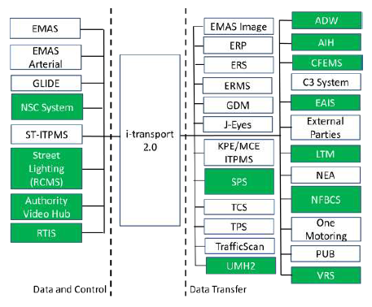
Critical / Less Critical Interfaces?
Critical External Systems shall mean systems provide control and data to i-transport 2.0
Less critical External Systems only provide data to i-transport 2.0
Final decision is made on LTA and SSA agreement in FD.

Slide 10
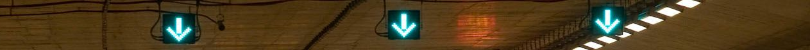
Some of the Key Equipment in i-transport
Traffic Light (a.k.a. “site” in GLIDE)
VMS (Variable Message Sign)
EMAS:
Traffic Information Panel, TIP (On Expressway)
Travel Time Panel, TTP (On Entrance)
Tunnel Entrance Panel, (Tunnel Entrance)
LUS
Traffic Sign Panel, TSP
Traffic Information Checkpoint Panel, TIC
EA:
Roadside Mount AVMS, RVMS
Cantilever AVMS, CVMS
PGS VMS
Short Tunnel:
Arterial Variable Message Sign, AVMS
Entrance Variable Message Sign, EVMS

Slide 11
Some of the Key Equipment in i-transport
Other Equipment
EMAS Tunnel Equipment, PMCS (Plant Management Control System)
From inside tunnel to Facility building
Inside Tunnel (E.g. Deluge System, Smoke detector, Jetfan, Ventilation System, Radio broadcast system, etc.)
Facility Building (E.g. Electric Door, Fire System, UPS, Electrical Circuit System, Calendar, etc.)
Short Tunnel Facility Building Equipment
Similar to EMAS Tunnel
Other system equipments,
E.g. TCS System Fix and Mobile Radar, TrafficScan System status, etc.

Slide 12
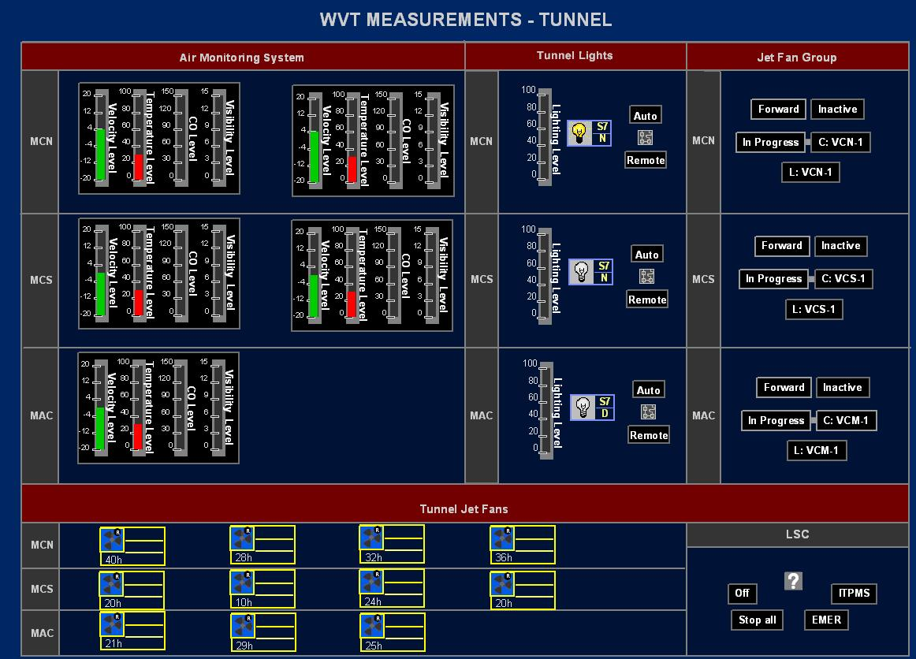
Key information in i-transport
Traffic Alerts
Systems can detect abnormal traffic situation and alert operators to recover the traffic situation
Technical Alarms, Reading Alarms
Technical Alarms are mainly referred to technical/system problem
Reading Alarms are normally referred to environment sensor alarms
Traffic Data
Multiple data source
Data Fusion
Incident & Event

Slide 13
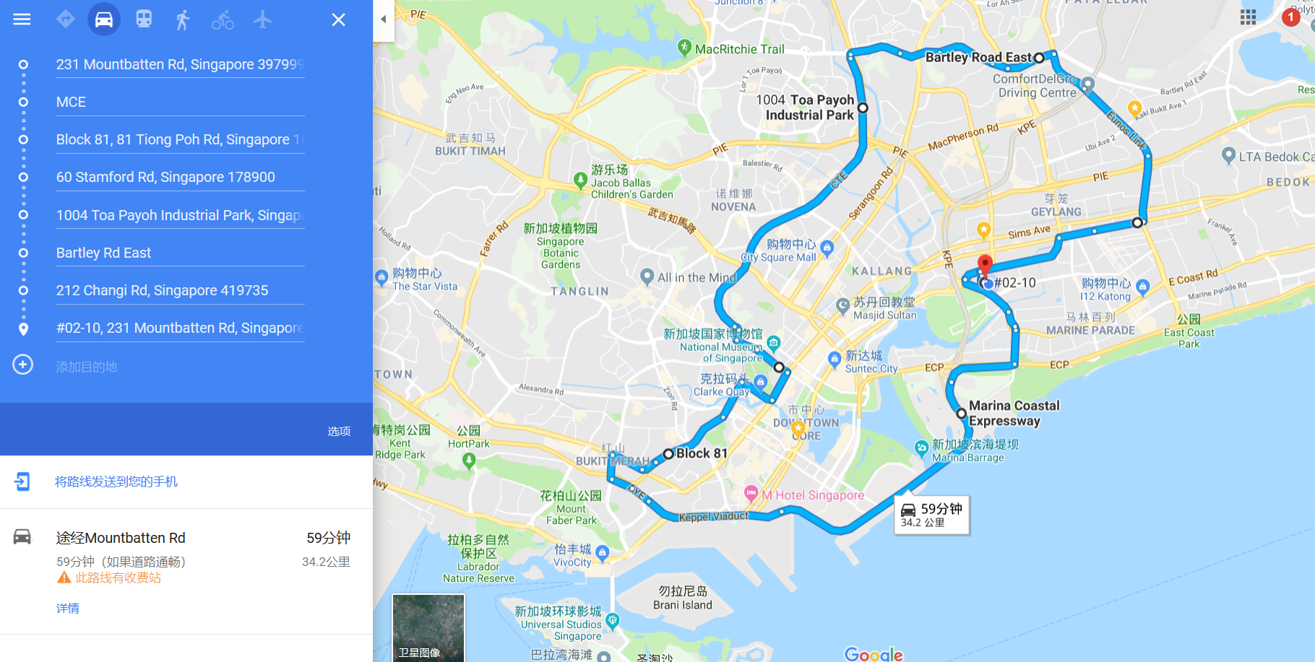
Bus Tour Today
EAC51 – Braddell Rd,
Bartley Rd,
Bartley Rd E,
Hougang Ave 3
Eurons Lk
CTE (Open Expressway)
CTE (Kg java Tunnel)
FCT Short Tunnel
CTE (Open Expressway)
MCE
EAC 56 – Keppel Road (Viaduct)

Slide 14

Delivering Transformation. Together.

